Slide 1
Applied Deep Learning
Homework 2
Kaggle Due: 2022/04/24 23:59
Code/Report Due: 2022/04/26 23:59

Slide 2
Links
NTU COOL
Kaggle
討論區
說明影片
adl-ta@csie.ntu.edu.tw
TA Hours:
星期四 4:00 pm ~ 5:30pm @ Google Meet (Online)

Slide 3
Change Log
3/22: Add allowed packages
3/22: Modify P.11, we only have 4 paragraphs for each question
3/22: Update the datasets so all questions have 4 passages
3/26: Update baseline numbers in P.14
3/26: Add hyperparameters and resources used for simple baseline in P.43
3/28: Clarify Q3
3/30: Clarify Q4
4/25: Add gdown as an allowed program P.19

Slide 4
Outline
Task Description
Logistics
Rules
Report

Slide 5
Task Description

Slide 6
Chinese Question Answering
Input: Context list
"鼓是一種打擊樂器，...，最早的鼓出現於西元前六千年的兩河文明"
"盧克萊修生於共和國末期，...，被古典主義文學視為經典"
"視網膜又稱視衣，...，約3mm2大的橢圓。"
Input: Question
"最早的鼓可以追溯至什麼古文明?"
Output: Answer
"兩河文明"

Slide 7
Properties
Model should predict the answer given contexts and a question.
The answer is always a span in one of the contexts.
This task can be decomposed into 2 tasks:
Context selection: determine which context is relevant.
Span selection: determine the start and end position of the answer span in the context.

Slide 8
Metrics
Exact Match (EM)
1 if prediction and answer are the same after preprocessing, 0 if they are different.

Slide 9
Data
Context data
context.json
Labeled Data
Training set: train.json
Validation set: valid.json (You can use this file for training model or only for validation)
Unlabeled Data
Testing set: test.json
Sample Submission
sample_submission.csv
Check NTU COOL homework 2 page for download link.

Slide 10
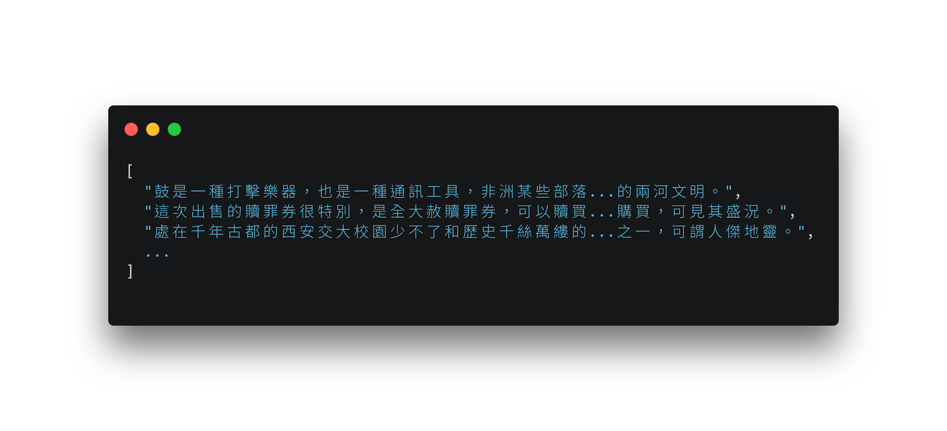
Data Format - context.json
list of short paragraphs

Slide 11
Data Format - questions
id: question ID
question: question text
paragraphs: list of 4 paragraph IDs (0-based)
relevant: ID of the relevant context (0-based) (* absent in test.json)
answer: answer to the question (* absent in test.json)
text: the answer text
start: answer span start position in the relevant context

Slide 12
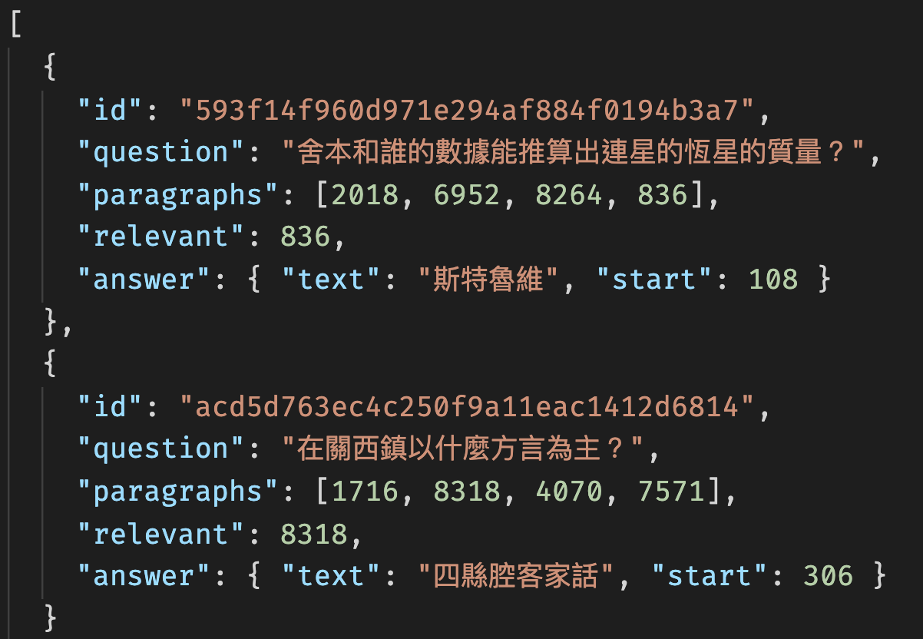
Data Format - questions

Slide 13
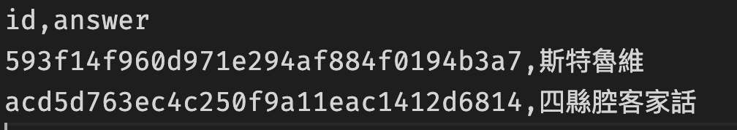
Submission Format
A CSV file whose header is id,answer
See sample_submission.csv
Example

Slide 14
Objective
Fine-tune a pre-trained Chinese BERT-based model on the dataset and pass the baselines.
Simple Baseline - (bert-base-chinese would be enough)
EM: Public 0.73056 (on Kaggle)
Strong Baseline - (You might need to explore other pretraining models)
EM: Public 0.75497 (on Kaggle)
For this homework, you can utilize the huggingface transformers package and pretrained model. You can adapt their example scripts to our task

Slide 15
Logistics

Slide 16
Grading
Model Performance (10%)
Your model passes the simple baseline on the public test set (2%) and the private test set (3%) on kaggle
Your model passes the strong baseline on the public test set (2%) and the private test set (3%) on kaggle
0 point if we can’t reproduce your submission using run.sh
Format (1%)
TA can run the grading script without human intervention.
Report (9% + 2% Bonus)
In PDF format!

Slide 17
Code/Scripts/Report/Result Submission
Zip your folder into a single .zip file.
Submit to NTU Cool.

Slide 18
File Layout
Your zip must contain files (case sensitive):
/[student id (lower-cased)]/, ex. /r12922000/, no brackets
run.sh
README.md
report.pdf
download.sh
Any other code/script.
Do not upload training, validation, testing data and model to COOL.

Slide 19
Submission Files - download.sh
download.sh to download your model.
Do not modify your file after deadline, or it will be seen as cheating.
Keep the URLs in download.sh valid for at least 2 weeks after deadline.
Do not do things more than downloading. Otherwise, your download.sh may be killed.
You can download at most 4G, and download.sh should finish within 1 hour. (At csie dept with maximum 10MB/s bandwidth)
You can upload your model to Dropbox. (see tutorial)
You can use gdown to download you model from Google Drive (please make sure we have the access to download)
We will execute download.sh before predicting scripts.

Slide 20
Submission Files - Scripts
run.sh
Arguments:
"${1}": path to the context file.
"${2}": path to the testing file.
"${3}": path to the output predictions.
TA will predict testing data as follow:
bash ./download.sh
bash ./run.sh /path/to/context.json /path/to/test.json /path/to/pred/prediction.csv
Specify the Python version (3.8 or 3.9) in the .sh file.
Default python version would be 3.8
Ex. python3.8 predict.py … / python3.9 predict.py … “python” would be python3.8
Make sure your code works!

Slide 21
Submission Files - Reproducibility
All the code you used to train, predict, plot figures for the report should should be uploaded.
README.md
Write down how to train your model with your code/script specifically.
If necessary, you will be required to reproduce your results based on the README.md.
If you cannot reproduce your result, you may lose points.
You will get at least - 2 penalty if you have no or empty README.md.

Slide 22
Execution Environment
Will be run on computer with
Ubuntu 20.04
32 GB RAM, GTX 3070 8G VRAM, 20G disk space available.
the packages we allow only.
python 3.8 / 3.9
Time limit: 2 hours for run.sh in total
No network access when predicting (after we run download.sh).
You will lose (some or all) your model performance score if
your script is at wrong location, or cause any error.

Slide 23
Rules

Slide 24
Kaggle
Displayed Team Name: [student_id]
e.g. r12345678
For auditing, Displayed Team Name: audit_[anything]
E.g. audit_4fun
You can submit your result 5 times a day for each task.
Any approaches to submit more than 5 times a day is prohibited!

Slide 25
What You Can Do
Train with the data we give you.
Use publicly available pre-trained BERTs and their variants.
Use the packages/tools we allow:
Python 3.8 / 3.9 and Python Standard Library
PyTorch 1.10.2, TensorFlow 2.8.0, pytorch-lightning 1.5.10
SpaCy 3.2.2 and NLTK 3.7 for non-model-based functions.
sentencepiece==0.1.96
tqdm, numpy, pandas, scikit-learn 1.0.2
transformers==4.17.0, datasets==2.0.0, accelerate==0.6.1
Dependencies of above packages/tools.
If you want to use other package, COOL/mail TA.

Slide 26
What You Can NOT Do
Any means of cheating or plagiarism, including but not limited to:
Use others' code from anywhere (e.g. web, github, classmate, etc.).
Use the labels of the test data directly or indirectly. (Do not try to find them.)
Use package or tools not allowed.
Use model trained with other QA/NLI data (If not sure, ask TA first).
Give/get model prediction to/from others.
Give/get trained model to/from others.
Publish your code before deadline.
Violation may cause zero/negative score and punishment from school.

Slide 27
Submission Policy
Submit to NTU Cool.
Late submission of "code and report":
0 day < late submission ≤ 1 day: original score * 0.95
1 day < late submission ≤ 3 day: original score * 0.90
3 day < late submission ≤ 4 day: original score * 0.75
4 day < late submission ≤ 5 day: original score * 0.50
5 day < late submission ≤ 6 day: original score * 0.25
6 day < late submission: original score * 0.00
Late submission is determined by the last submission.
Update your submission after deadline implies that you will get penalty.

Slide 28
Report

Slide 29
You may lose score if TA has difficulty understanding it.
Please write in a human-readable way.

Slide 30
When Describing Model
Please limit the use of imprecise words.
Use equation whenever possible.
Descriptions which is imprecise or hard to understand may cause loss of points.
Ex.
bad: Feed the embedding of the sentence into a LSTM.
good: h_{t}, c_{t} = LSTM(w_{t}, h_{t-1}, c_{t-1}), where w_{t} is the word embedding of the t-th token.

Slide 31
Q1: Data processing (2%)
Tokenizer (1%):
Describe in detail about the tokenization algorithm you use. You need to explain what it does in your own ways.
Answer Span (1%):
How did you convert the answer span start/end position on characters to position on tokens after BERT tokenization?
After your model predicts the probability of answer span start/end position, what rules did you apply to determine the final start/end position?

Slide 32
Q2: Modeling with BERTs and their variants (4%)
Describe (2%)
your model (configuration of the transformer model)
performance of your model.
the loss function you used.
The optimization algorithm (e.g. Adam), learning rate and batch size.
Try another type of pretrained model and describe (2%)
your model
performance of your model
the difference between pretrained model (architecture, pretraining loss, etc.)
For example, BERT -> xlnet, or BERT -> BERT-wwm-ext. You can find these models in huggingface’s Model Hub.

Slide 33
Q3: Curves (1%)
Plot the learning curve of your QA model
Learning curve of loss (0.5%)
Learning curve of EM (0.5%)
You don’t need to calculate the metrics in every iteration. Please make sure there are at least 5 data points in each curve.

Slide 34
Q4: Pretrained vs Not Pretrained (2%)
Train a transformer model from scratch (without pretrained weights) on the dataset (you can choose either MC or QA)
Describe
The configuration of the model and how do you train this model
the performance of this model v.s. BERT
Hint: you can use the same training script for this problem, just skip the part where you load the pretrained weights
Hint: the model size configuration for BERT might be too large for this problem, if you find it hard to train a model of the same size, try to reduce model size (num_layers, hidden_dim, num_heads). Remember to report the model configuration.

Slide 35
Q5: Bonus: HW1 with BERTs (2%)
Train a BERT-based model on HW1 dataset and describe
your model
performance of your model.
Intent classification (1%)
Slot tagging (1%)
the loss function you used.
The optimization algorithm (e.g. Adam), learning rate and batch size.

Slide 36
Guide

Slide 37
Pipeline
Context₁
Context Selection
Question
Answering
Context₂
Correct
Context
Answer
Context_{n}
Question
Question

Slide 38
Context Selection
In the first stage, you should train a model to select the relevant context
A simple way to do this is by using the BertForMultipleChoice model in Huggingface transformers (example)
For each question, you can view a (context, question) pair as a choice, and then ask the model to predict the correct choice
Softmax
Linear
[CLS]
Question
[SEP]
Context₁
[SEP]
[CLS]
Question
[SEP]
Context₂
[SEP]
...
[CLS]
Question
[SEP]
Context_{n}
[SEP]

Slide 39
Context Selection
By making the format of our dataset the same as the expected format of the example script (SWAG dataset), you can use the script to train a context selection model out-of-the-box.
The default ratio of the example script is 1 positive : 3 negative.

Slide 40
Context Selection
Some tricks to reduce memory usage:
Use gradient accumulation to reduce memory usage without changing effective batch size, we do not encourage simply reducing batch size as it might hurt performance
Effective batch size = batch_size * gradient_accumulation_steps
We recommend using max_length=512

Slide 41
Question Answering
The easiest way to do this is by using/modifying the script from huggingface transformers. If you make the format of our dataset the same as their expected format (SQuAD dataset), you can use the script out-of-the-box.
You can simply use the relevant context and the corresponding answer to train your model for this task, let the context selection model handle the selection part

Slide 42
Question Answering
If you do the preprocessing yourself, be careful handling the position of answer_span after tokenization. BERT uses subword tokenization which split a word into subwords, thus changing the start_position of the correct span.
Use the start_position to identify the correct span. Do not use something like context.index(“兩河流域”) as you might find another appearance of the answer text, which does not contain the clue to answer the question, such that the model could not learn how to do answer questions.

Slide 43
Question Answering
If the input length is longer than 512, or you want to truncate the input text, be careful of the answer_span. You should keep the correct span in the truncated input text, otherwise there will be no answer to select.
If you use the example scripts in the transformers library out-of-the-box, they deal this part for you.
We recommend using the postprocessing function in the transformers library.

Slide 44
Simple Baseline Hyperparameters
Context classification
Pretrained model: bert-base-chinese
Max_len: 384
Batch_size: 2 (per_gpu_train_batch_size 1 * gradient_accumulation_steps 2)
Num_train_epochs: 1
Learning_rate: 3e-5
Total running time: < 2 hours
Question answering
Pretrained model: bert-base-chinese
Max_len: 384
Batch_size: 2 (per_gpu_train_batch_size 1 * gradient_accumulation_steps 2)
Num_train_epochs: 1
Learning_rate: 3e-5
Total running time: < 1 hour
Resource used: Nvidia RTX 3070 with 8GB memory

